Slide 1
Hill Climbing Greedy Local Search

Slide 2
Path vs. State Optimization
• Previous lecture: path to goal is solution to problem
– systematic exploration of search space
• This lecture: a state is solution to problem – for some problems path is irrelevant. – E.g., 8-queens
• Different algorithms can be used
– Depth First Branch and Bound – Local search

Slide 3
Hill climbing
Local Search algorithm – operate using a single current state and generally move only to neighbours of that state – little memory – often find reasonable solutions in large state space – useful for solving optimization techniques
Hill climbing is simply a loop that continually moves in the direction of increasing value – that is uphill.
It terminates when it reaches “ peak” where no neighbour has a higher value.
Hill climbing does not look ahead beyond the immediate neighbours.
Hill climbing is called greedy local search because it grabs good neighbour

Slide 4
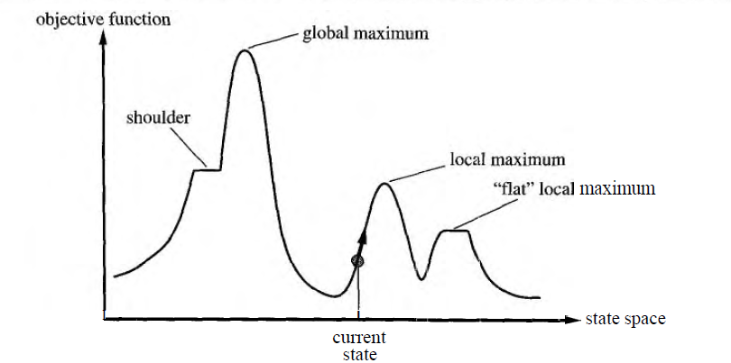
Hill climbing

Slide 5
Simple Hill climbing algorithm
1. Evaluate the initial state.
2. Loop until a solution is found or there are no new operators left to be applied:
Select and apply a new operator.
Evaluate the new state:
If it is a goal state then return it and quit.
If better than current state then make it the current state.
If not better than the current state then continue in the loop

Slide 6
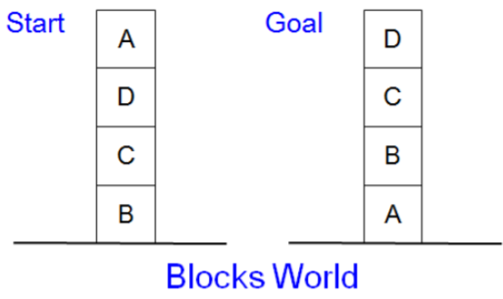
Local heuristic:
+1 for each block that is resting on the thing it is supposed to be resting on.
-1 for each block that is resting on a wrong thing

Slide 7
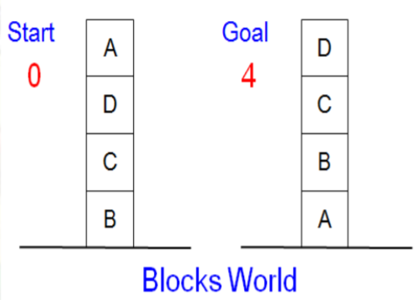
Initial State Score:
0 +1(for C & D) and -1(for B & A)
Total Score: 2-2=0
Goal State Score: 4 +1(for A,B,C & D) Total Score: 4

Slide 8
There is only one move from the Initial State i.e. move block A to the table
0
A
2
D
D
C
C
B
B
A
Now the New State has score 2 ,+1 for A,C & D while -1 for B
Total Score(3-1=2).

Slide 9
From the new state there are 3 possible states. All these states have scores 0. Hill Climbing halt because all these states have lower score then the current state. The process has reached a local maximum
2
D
C
0
B
A
A
D
0
0
C
C
D
C
B
B
A
B
A
D

Slide 10
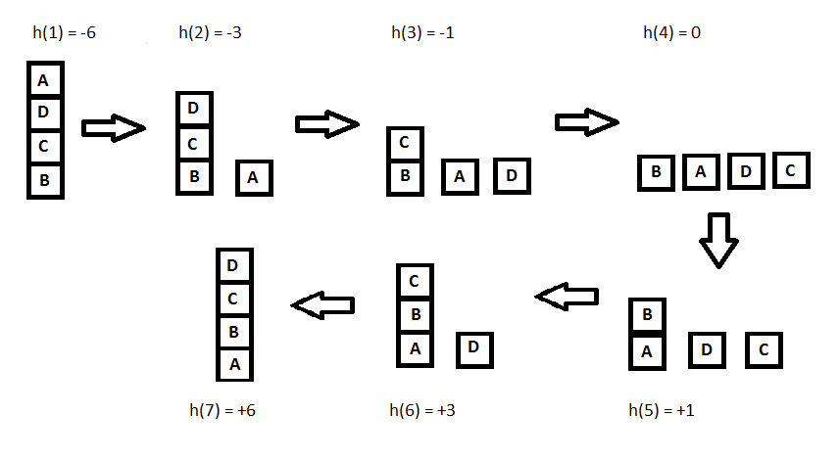
Let's define such function h:
h(x) = +1 for all the blocks in the support structure if the block is correctly positioned otherwise -1 for all the blocks in the support structure.

Slide 11
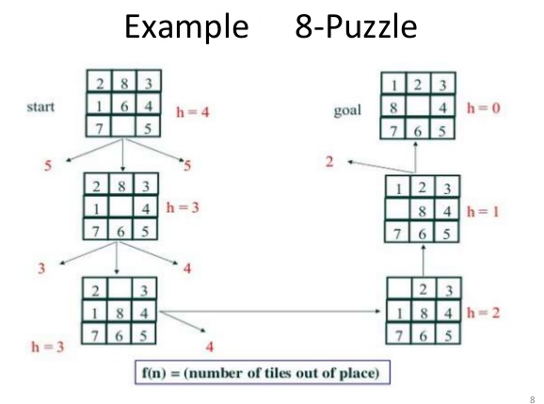

Slide 12
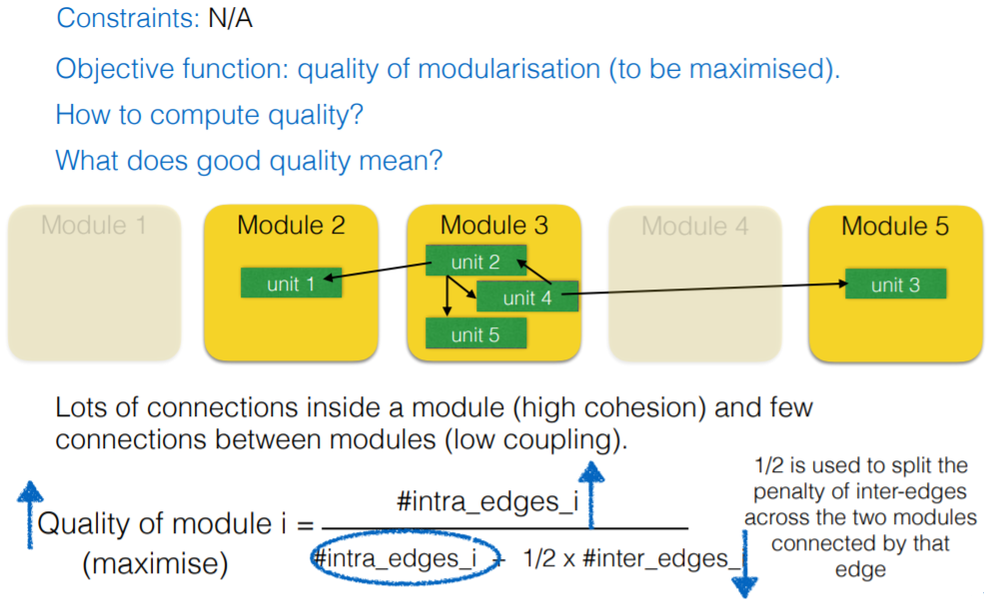
Formulating Software Module Clustering as an Optimization Problem

Slide 13
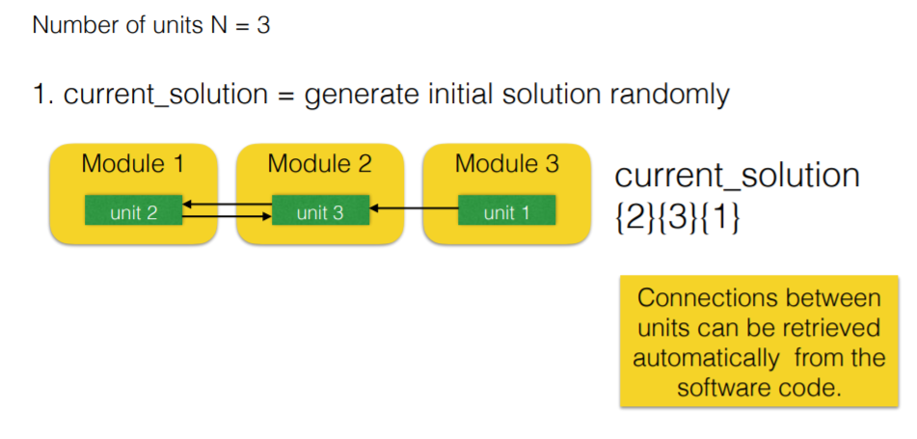

Slide 14
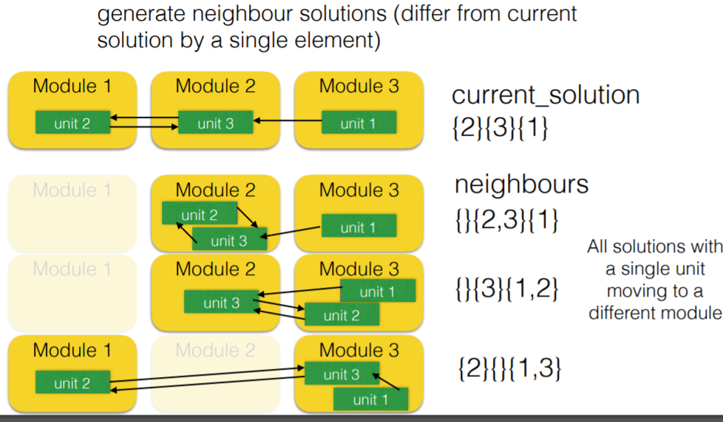

Slide 15
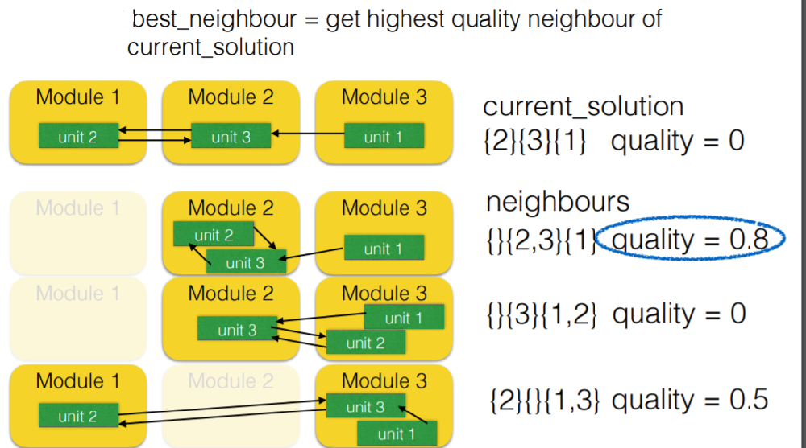

Slide 16
Drawback
Local maxima: a local maximum is a peak that is higher than each of its neighboring states but lower than the global maximum.
Plateau: a plateau is a flat area of the state-space landscape. It can be a flat local maximum, from which no uphill exit exists, or a shoulder, from which progress is possible. A hill-climbing search might get lost on the plateau
Ridges: Ridges result in a sequence of local maxima that is very difficult for greedy algorithms to navigate

Slide 17
Hill Climbing Search
When the state-space landscape has local minima, any search that moves only in the greedy direction cannot be complete
At each step do one of the two – Greedy: With prob p move to the neighbour with largest value – Random: With prob 1-p move to a random neighbour
Random walk, on the other hand, is asymptotically complete Idea: Put random walk into greedy hill-climbing

Slide 18
Simulated Annealing
A Hill-climbing algorithm that never makes “downhill” moves towards states with a lower value (higher cost) is guaranteed to be incomplete, because it can get stuck on a local maximum
Instead, a random walk can uniformly select a node from the successors
Hill climbing – efficient but incomplete
Random walk – inefficient and complete
Hill climbing + random walk : efficient and complete

Slide 19
Simulated Annealing
In metallurgy, annealing is the process used to temper or harden metals and glass by heating them to a high temperature and then gradually cooling them, thus allowing the material to reach a low energy crystalline state

Slide 20
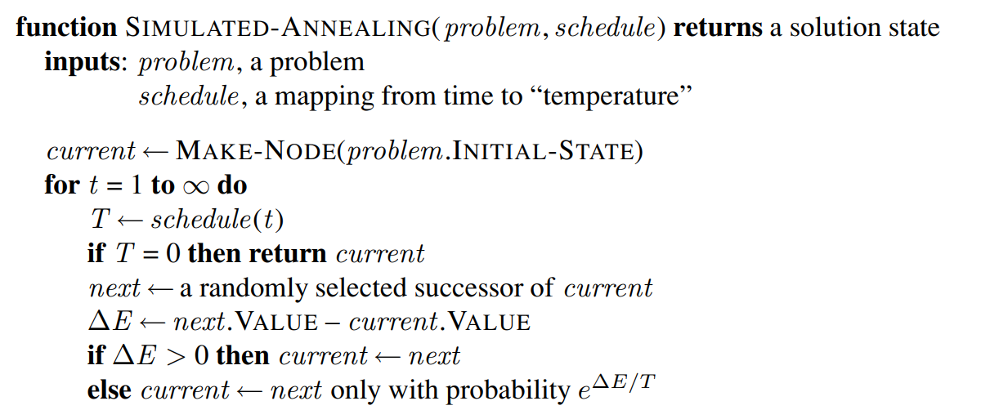
Simulated Annealing

